Slide 1


NASA’ s monitoring systems impediment
Our solution (Sensory system , Local factors , the identification of the
Danger area.

Slide 2
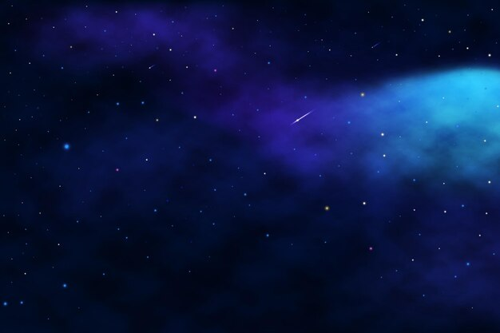

During a wildfire, several key parameters undergo significant alterations Variations in infrared radiation levels. Fluctuations in atmospheric carbon monoxide (CO) concentrations. Notable shifts in ambient temperatures. Changes in humidity levels.

Slide 3

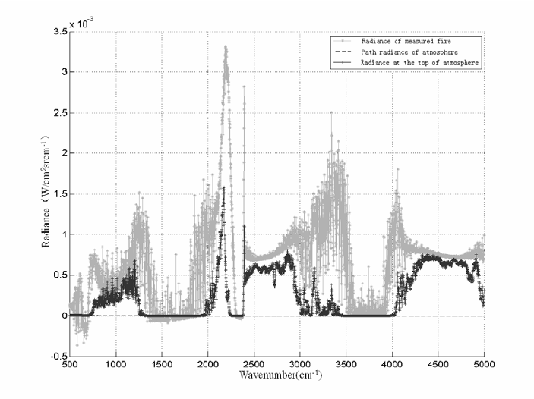
Radiation levels during wildfire

Slide 4
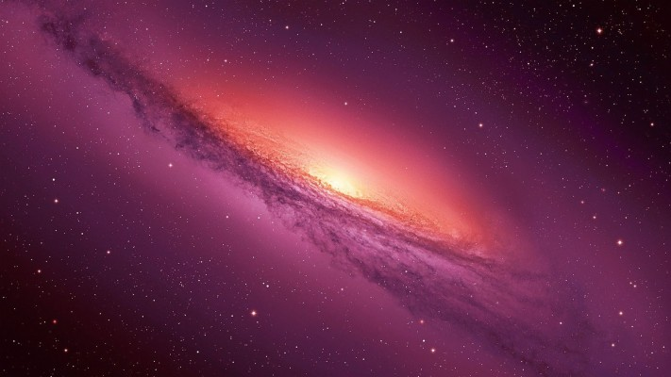
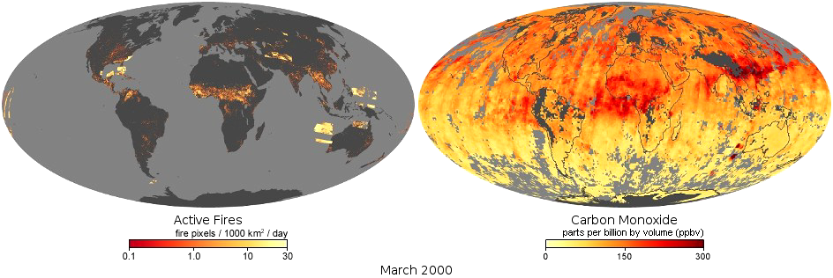
Carbon monoxide concentration

Slide 5
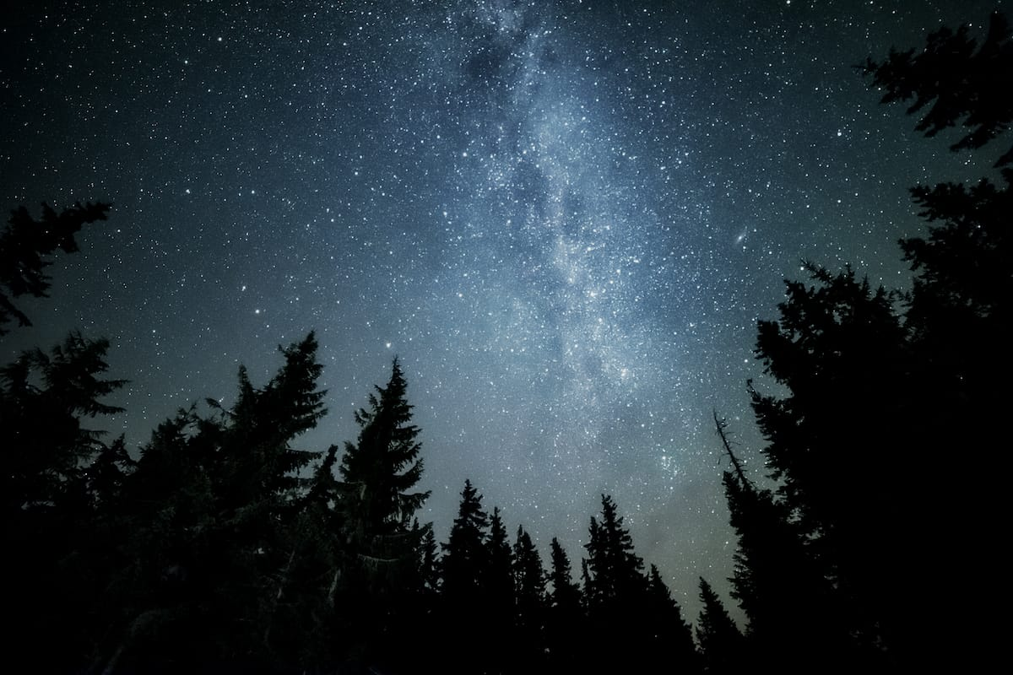
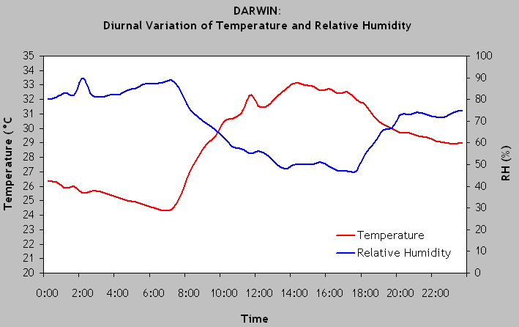

Slide 6
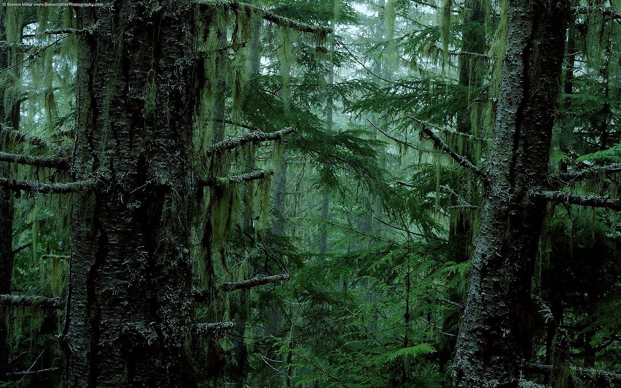
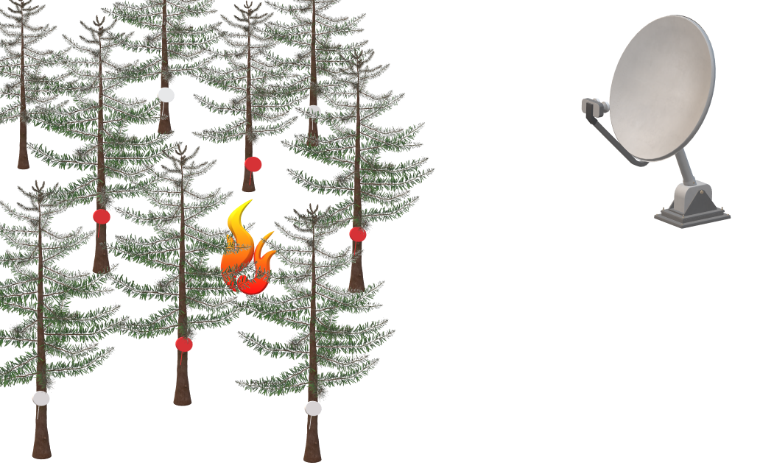

Slide 7
